Slide 1
ALPhA Week 15: (4/26/19 – 4/3/19)
Gray Selby
AT-TPC Alpha – Alpha Classification

Slide 2
Plots
Saved events as numpy arrays
I made three sets with charge thresholds 50, 55, and 60
Used the pretrained VGG16 CNN to cluster event images by their features

Slide 3
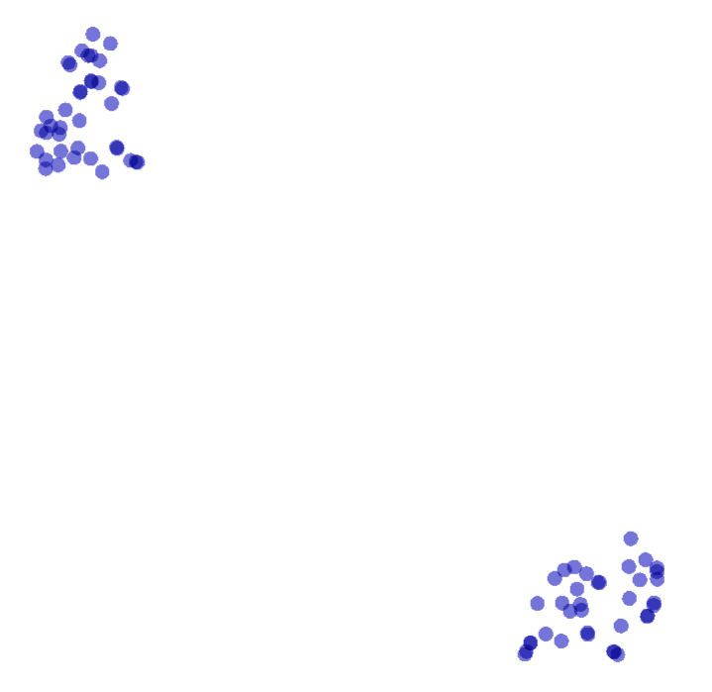
VGG16 clustering
Creatively named: Upper left cluster
The model successfully clustered images into two groups (38 events in the upper left, 36 events in the lower right)
This clustering is of images with a peak charge threshold of 50 (low)
Creatively named: lower right cluster

Slide 4
Upper left cluster (charge threshold of 50)
The majority of the cluster shown in the upper left contain ‘junk’ events but there are some alpha and/or proton events in the mix as well

Slide 5
Junk events in upper left cluster

Slide 6
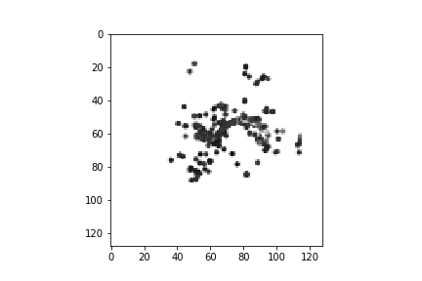
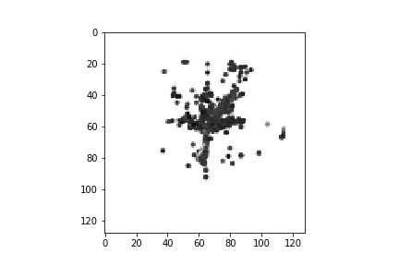
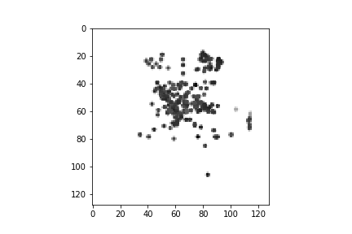
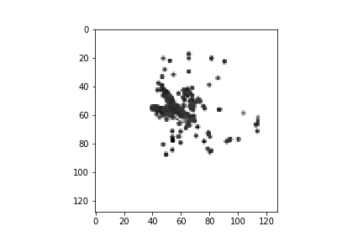
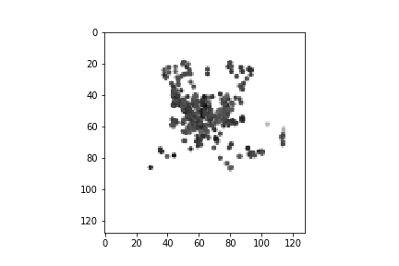
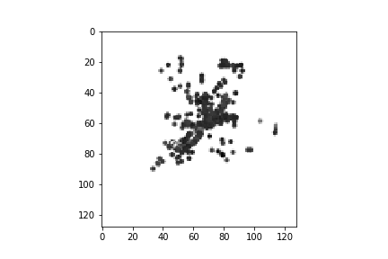

Slide 7
Particle events in upper left cluster

Slide 8
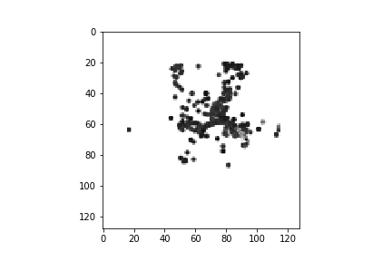
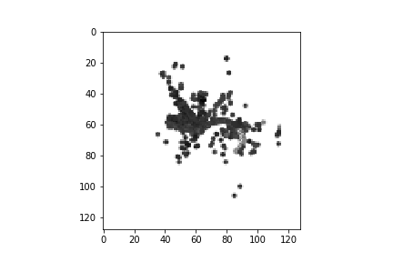
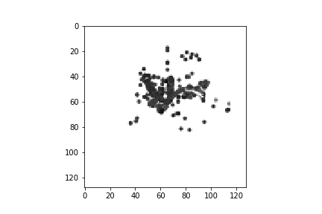
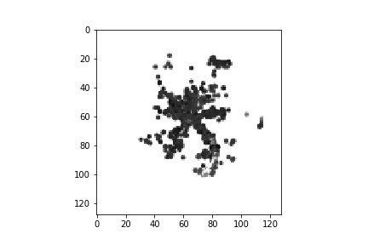
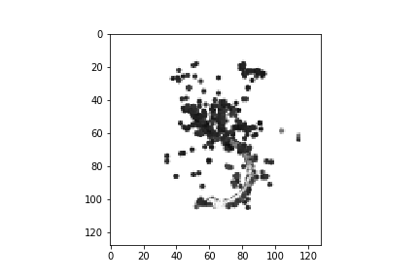

Slide 9
There were some images clustered essentially on top of each other

Slide 10
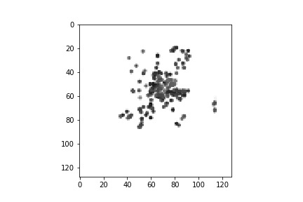
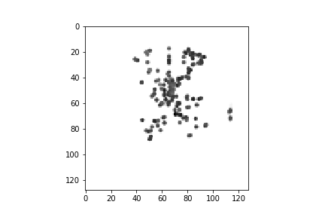

Slide 11
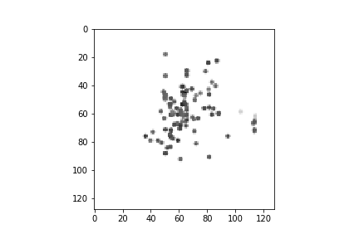
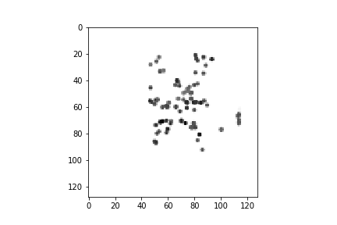

Slide 12
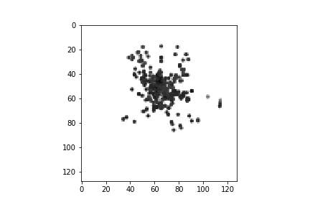
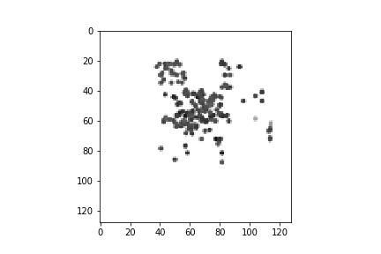

Slide 13
Onto the lower right cluster

Slide 14
Lower right cluster (charge threshold of 50)
The majority of the cluster shown in the lower right cluster contains a larger percentage of particle events.
It also contains images over-saturated with high charge values even after normalization and a few ‘junk’ events

Slide 15
Particle events in lower right cluster

Slide 16
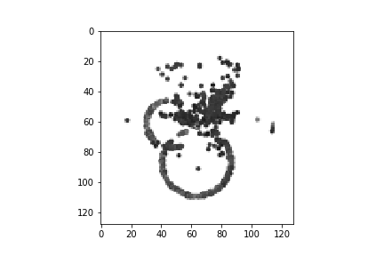
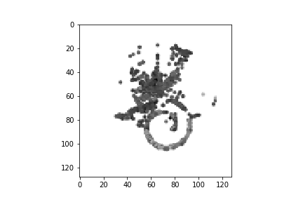
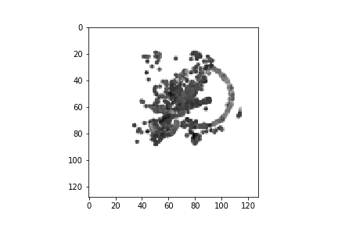
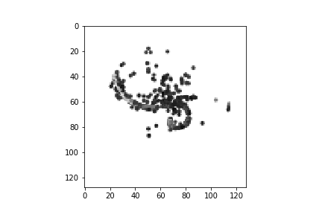
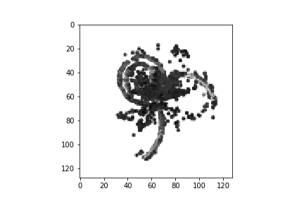
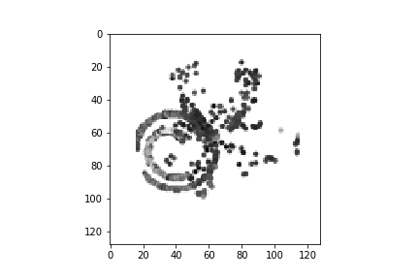

Slide 17
Over-saturated images in lower right cluster

Slide 18
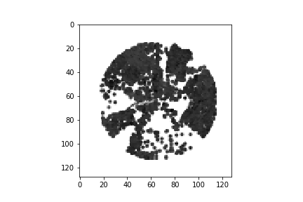
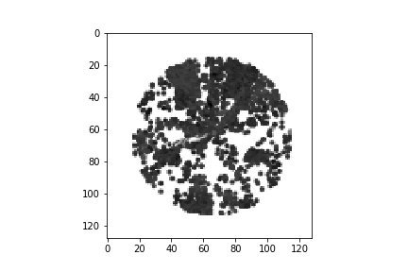
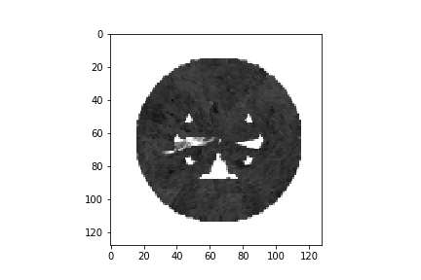
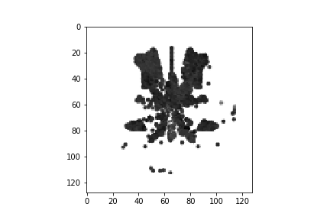

Slide 19
‘junk’ events in lower right cluster

Slide 20
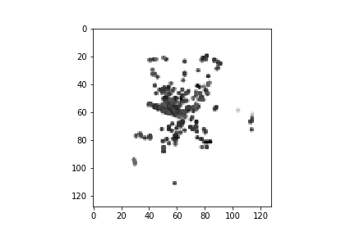
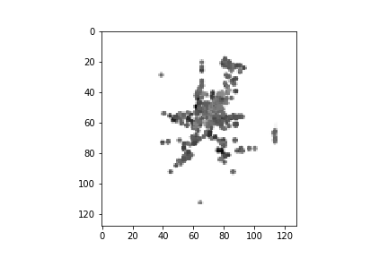
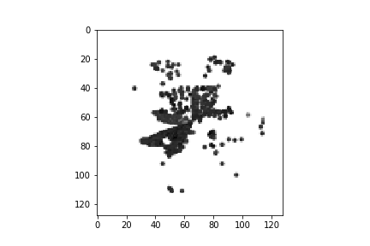
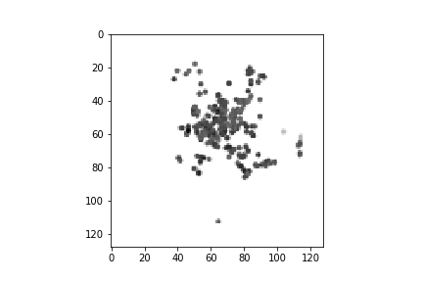
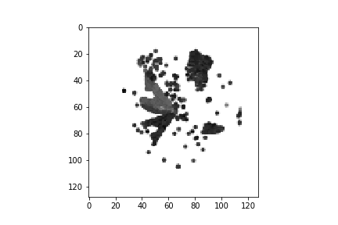
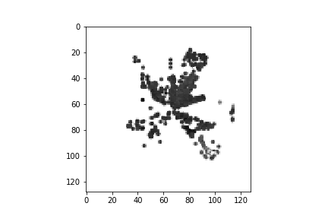

Slide 21
There were some images clustered essentially on top of each other

Slide 22
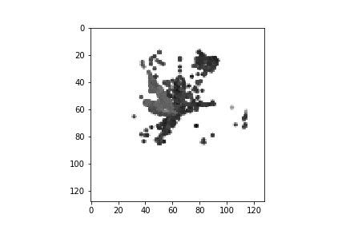

Slide 23
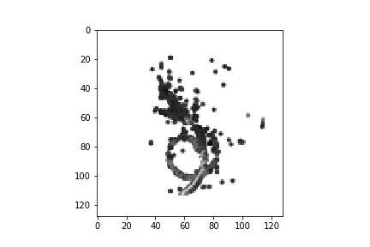
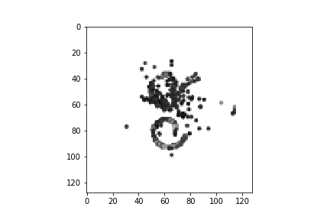

Slide 25
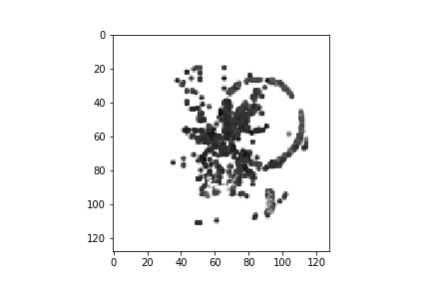

Slide 27
Next Steps
Invert the color of the images so that low charge corresponds to a white while high charge corresponds to a black
Update the method of determining a ‘hit’ on a pad
There should only be one charge value per pad for an event, even if there are multiple “peak charge values” in a trace
Both of these improvements should change the outcome of our feature clustering

